Slide 1
Product of any 5 consecutive integers is divisible by 120
MADHUMITHA S-19PW13

Slide 2
Direct Proof
Assume p : (n+1)(n+2)(n+3)(n+4)(n+5) are 5 consecutive integers in multiplication
To prove – q : 5 consecutive integers is divisible by 120 i.e, (p->q)
Let 5 consecutive natural number be (n+1),(n+2)........,(n+5) Product is, P=(n+1)(n+2)(n+3)(n+4)(n+5)
⇒ P = n!(n+1)(n+2)(n+3)(n+4)(n+5) ​= (n+5)!​×5! = ^{n+5}C₅×5! = 5!× Integer n! n!5!
Hence the product of 5 natural number is always divisible by 5!=120

Slide 3
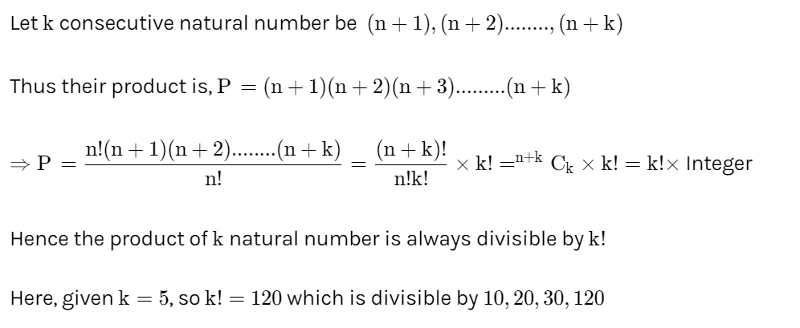

Slide 4
PROOF BY CONTRADICTION
Lets assume that the product of 5 integers is not divisible by 120
Solution :
In any sequence of p numbers, exactly one of those values will be divisible by p.
(In other words, one out of every p values is divisible by p).Therefore:
At least 1 value is divisible by 5 ( since we have a sequence of 5 numbers)
At least one value is divisible by 3 (since you have a sequence of >= 3 values)
At least one value is divisible by 4 (since you have a sequence of 4 values)
Two values are divisible by 2 (since you have two sequences of 2 values). One of those values is divisible by 4, but you still have one other 2 factor.
Thus , our assumption is false and the product of any sequence of 5 values is divisible
by 120= 5*4*3*2.

Slide 5
THANKYOU

